Slide 1
TTF ML Predictions

Slide 2
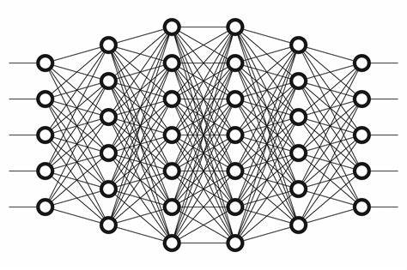
Case 1a: 1 soil
Create 500 examples with Vs ranging from 100 to 800 m/s.
Vs
TF @ freq
Freq

Slide 3
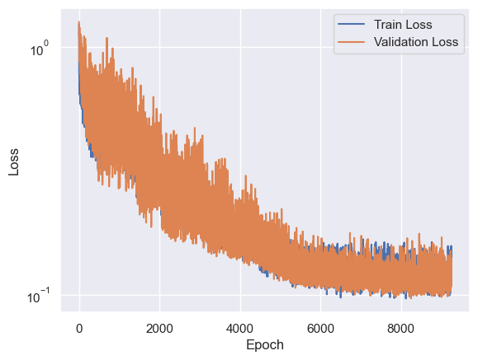
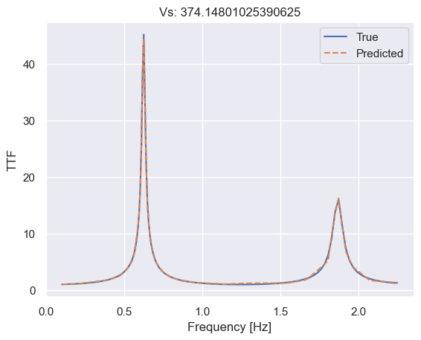
Results

Slide 4
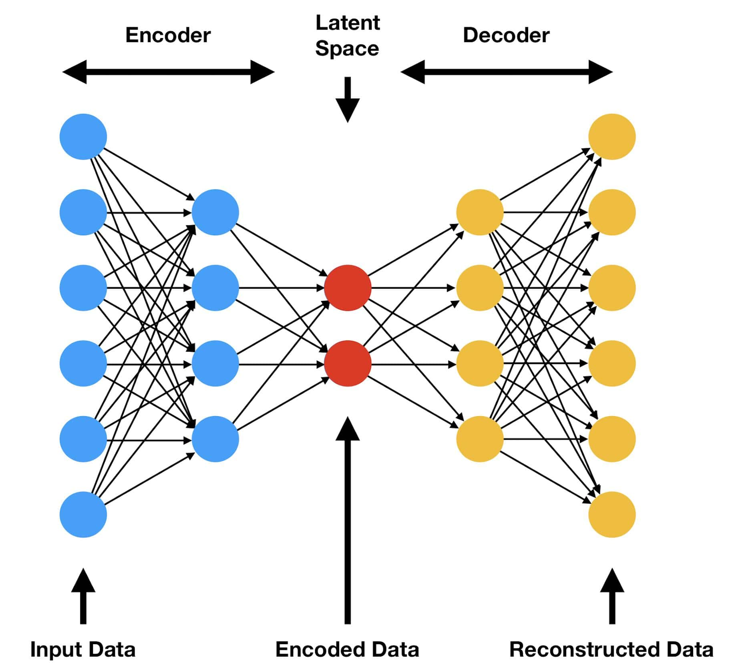
Case 1a: 1 soil
Transformer approach: Calculate the complete TF function
Vs
TTF

Slide 5
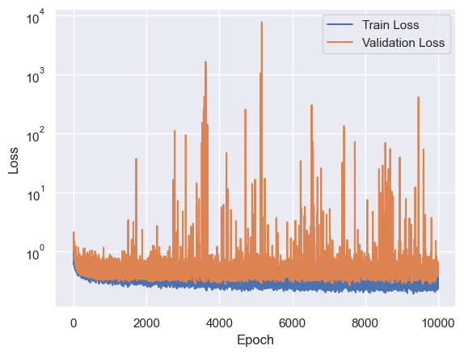
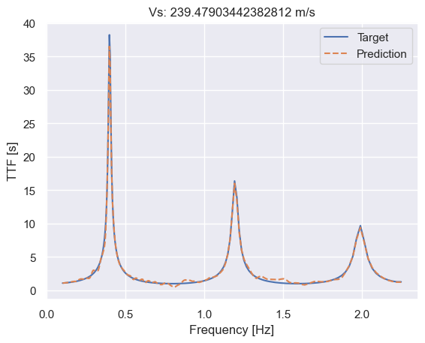
Results

Slide 6
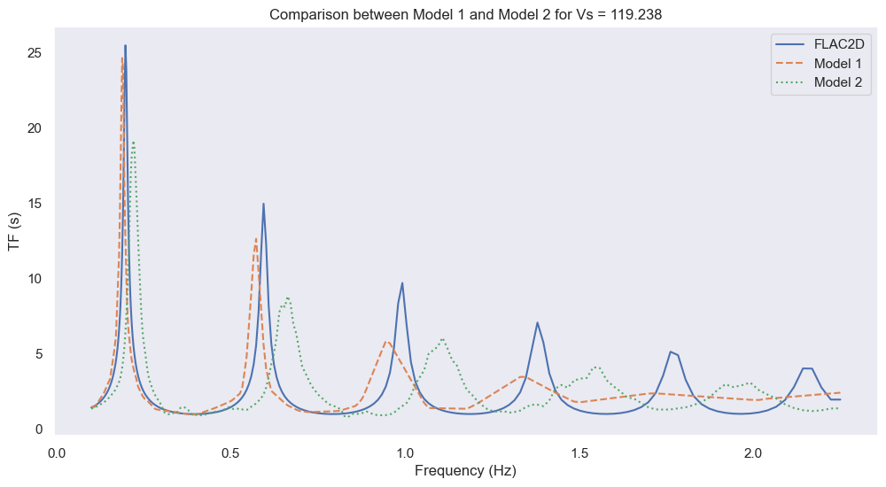
Comparison

Slide 7
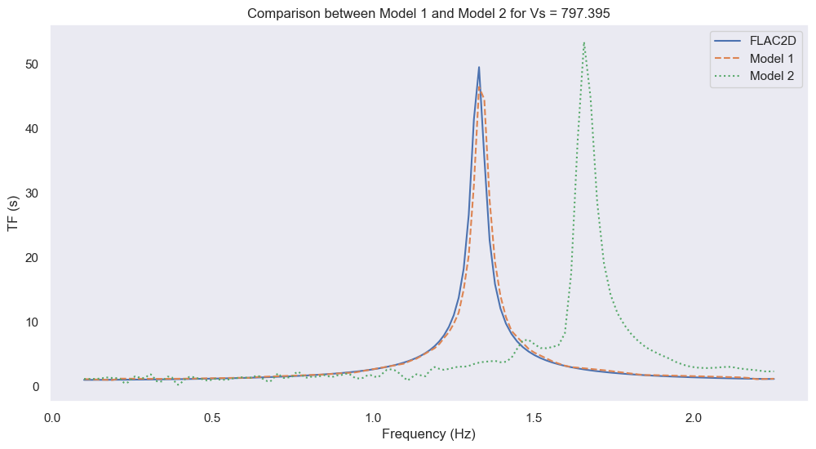
Comparison

Slide 8
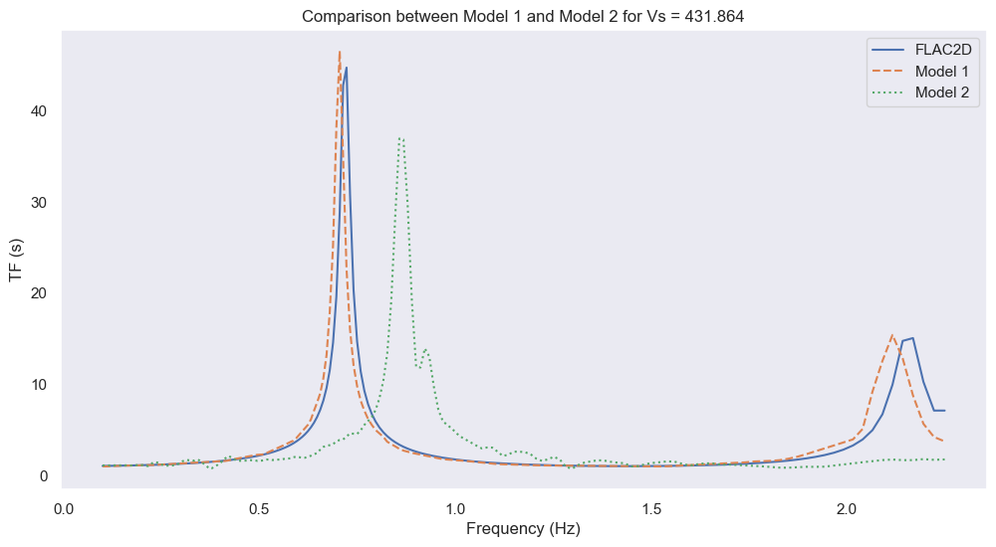
Comparison

Slide 9
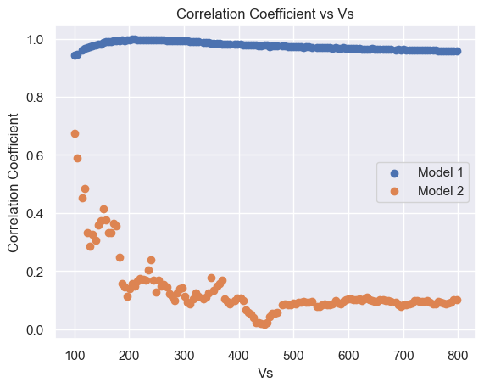
Comparison Correlation Coefficient

Slide 10
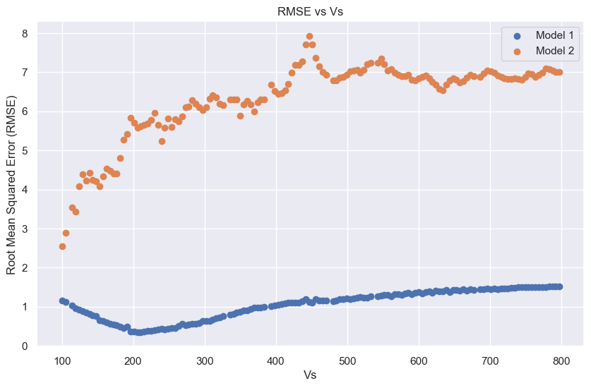
Comparison RMSE

Slide 11
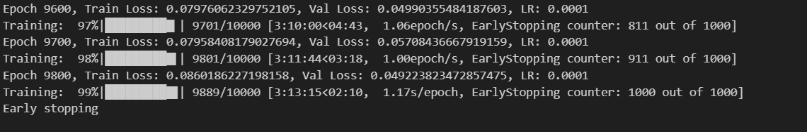
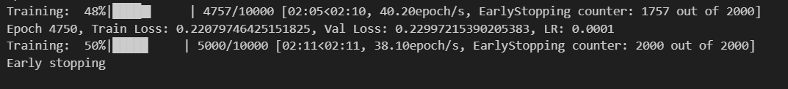
Comparison – Computational Time
Model 1
Model 2

Slide 12
Issue:
Not good correlation at multiple peaks Vs
When applicable to more than 1 layer of soil, results are close to random.
Need to impose a sequence input (where order matters) than a feed-forward MLP.

Slide 13
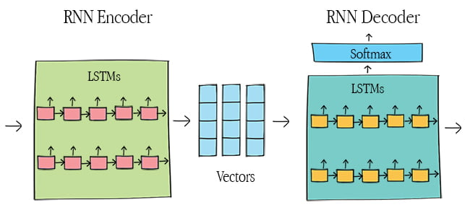
Approach 3: Using RNN
Sequence to sequence (or Seq2Seq) have the ability to understand the order of sequences.
TTF
Vs
CNN

Slide 14
Notes
Log transformation
Increased number from 256 to 1000

Slide 15
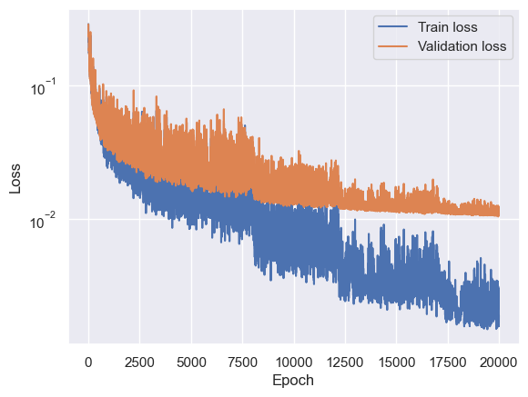
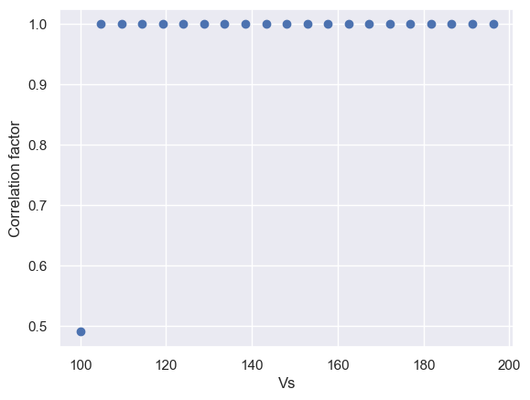
Model with LSTM

Slide 16
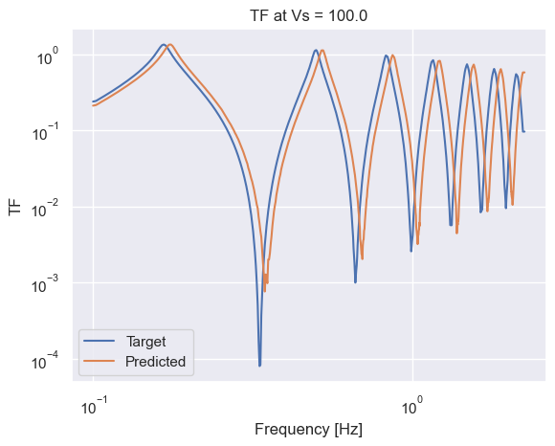
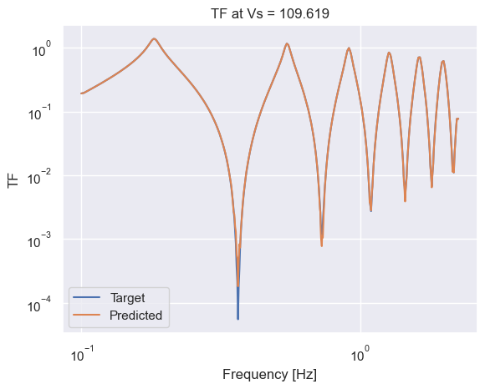
Results

Slide 17
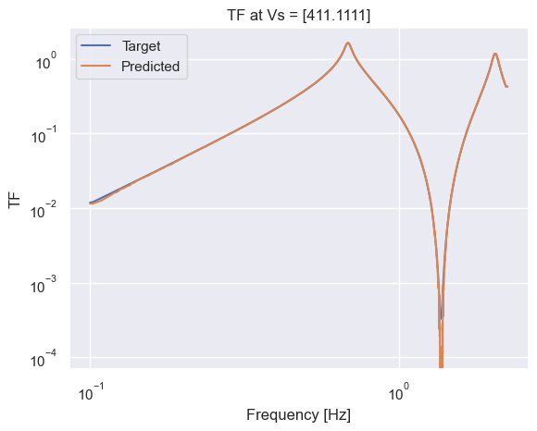
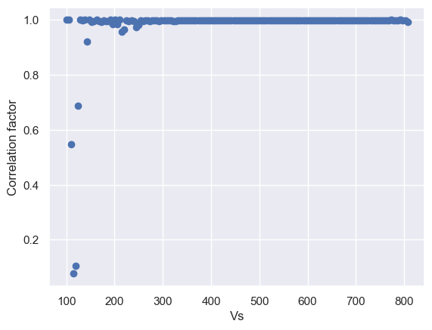
Results

Slide 18
How well does the model perform?

Slide 19
Issues and possible future work
Is the model really learning?
A lot of hyperparameters:
RNN / GRU / LSTM?
One or Bi RNN?
How many CNN Layers?
Batch size?
How many points of TF? 1000?
Perturbations
Changing grid
Attention?

Slide 20
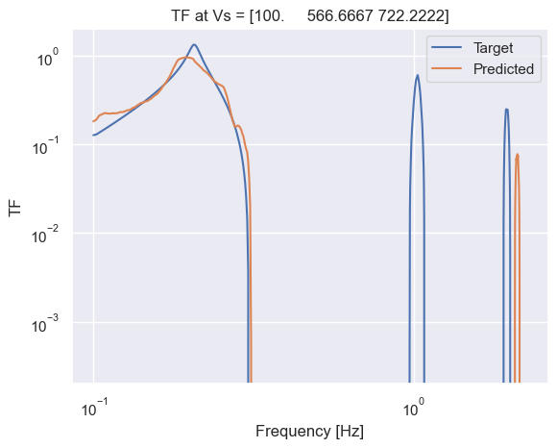
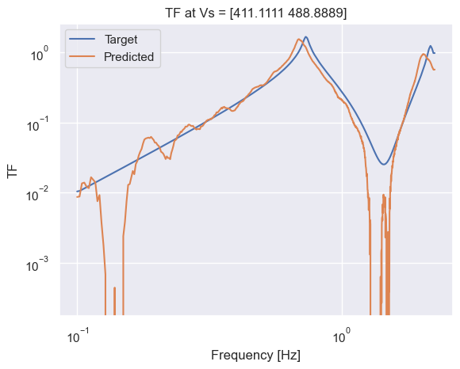
Work in progress: 1D Multiple Soils

Slide 21
Learning lessons
Peak regression requires sparsity: L1Loss is best suited due to not penalizing distance as much as MSE.
RNN correctly understands the sequence of Vs profiles
Use of EarlyStopping to avoid overfitting of training

Slide 22
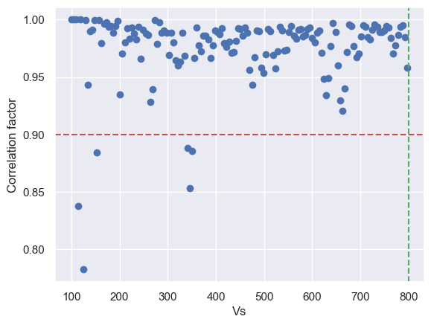
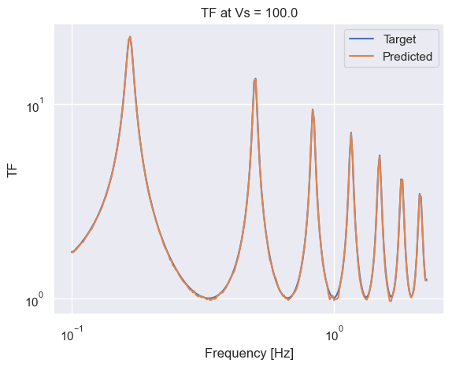
Baseline

Slide 23
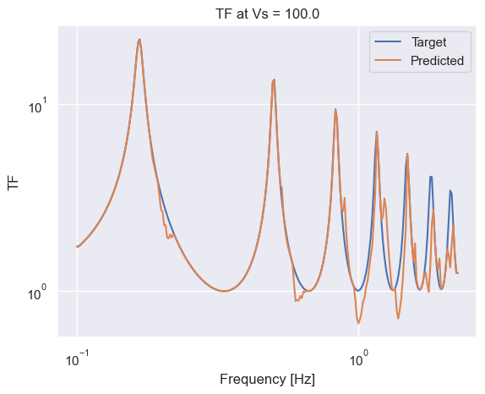
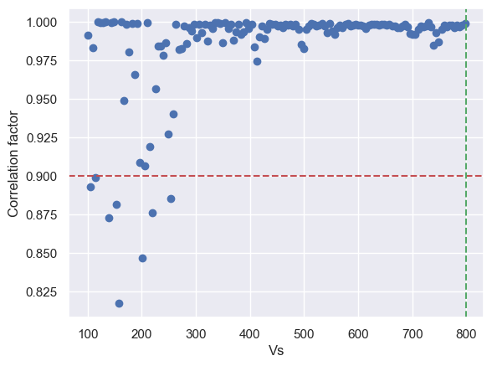
Only log10 transformation

Slide 24
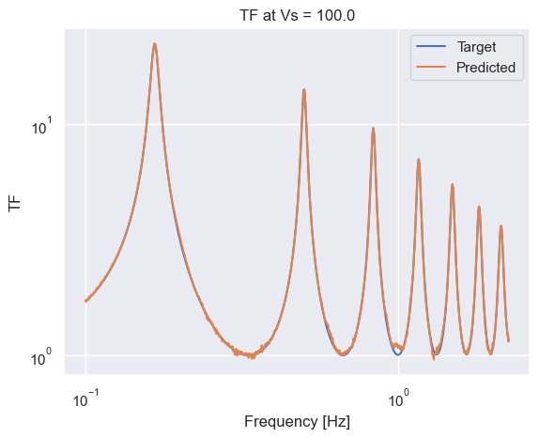
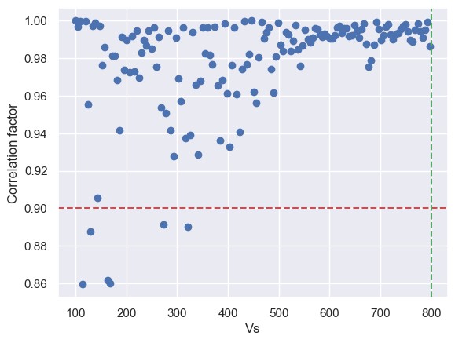
Only increasing points

Slide 25
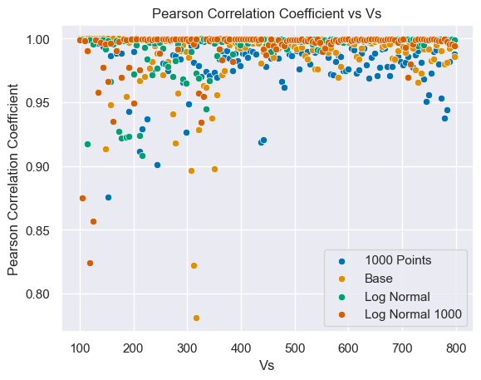
Overall results

Slide 26
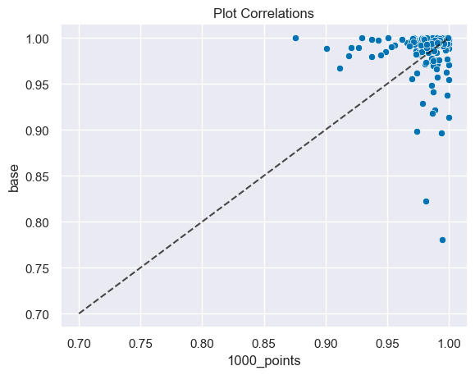
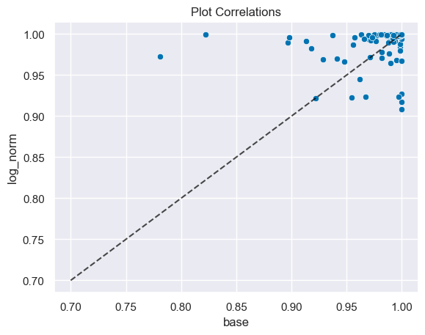
Comparison
Above - base: 69.18 %,
Below - 1000_points: 30.82 %
Above - log_norm: 67.81 %,
Below - base: 32.19 %

Slide 27
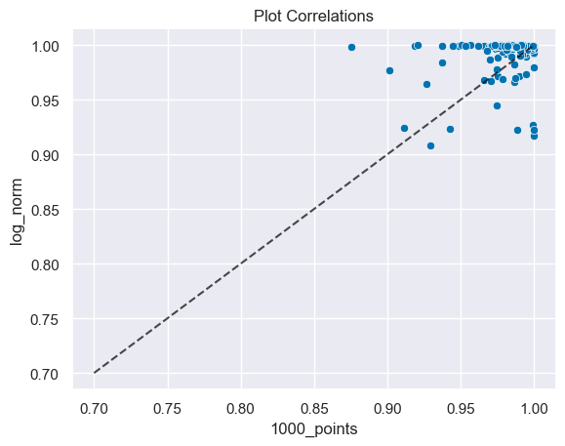
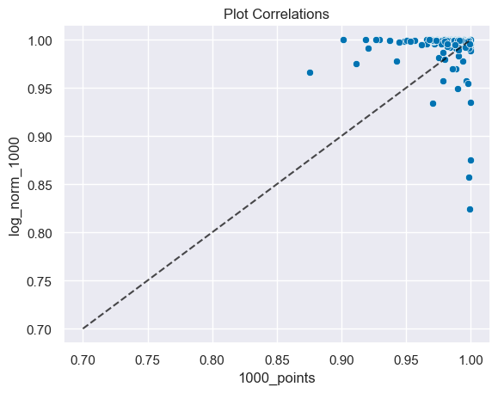
Comparison
Above - log_norm: 75.34 %,
Below - 1000_points: 24.66 %
Above - log_norm_1000: 78.77 %,
Below - 1000_points: 21.23 %

Slide 28
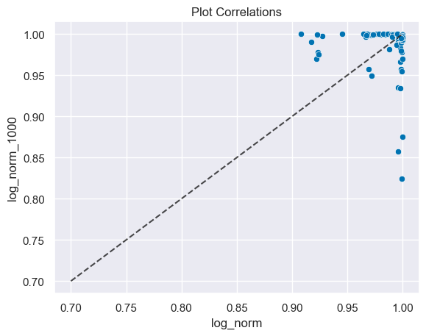
Comparison
Above - log_norm_1000: 44.52 %,
Below - log_norm: 55.48 %

Slide 29
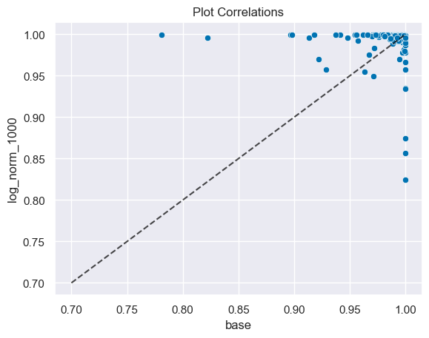
Comparison
Above - log_norm_1000: 73.29 %,
Below - base: 26.71 %

Slide 30
Comparison
 |  | Is greater
 |  | base | 1000_points | log_norm | combined
Compared to | base |  | 0 | 1 | 1
 | 1000_points | 1 |  | 1 | 1
 | log_norm | 0 | 0 |  | 0.5
 | combined | 0 | 0 | 0.5

Slide 31
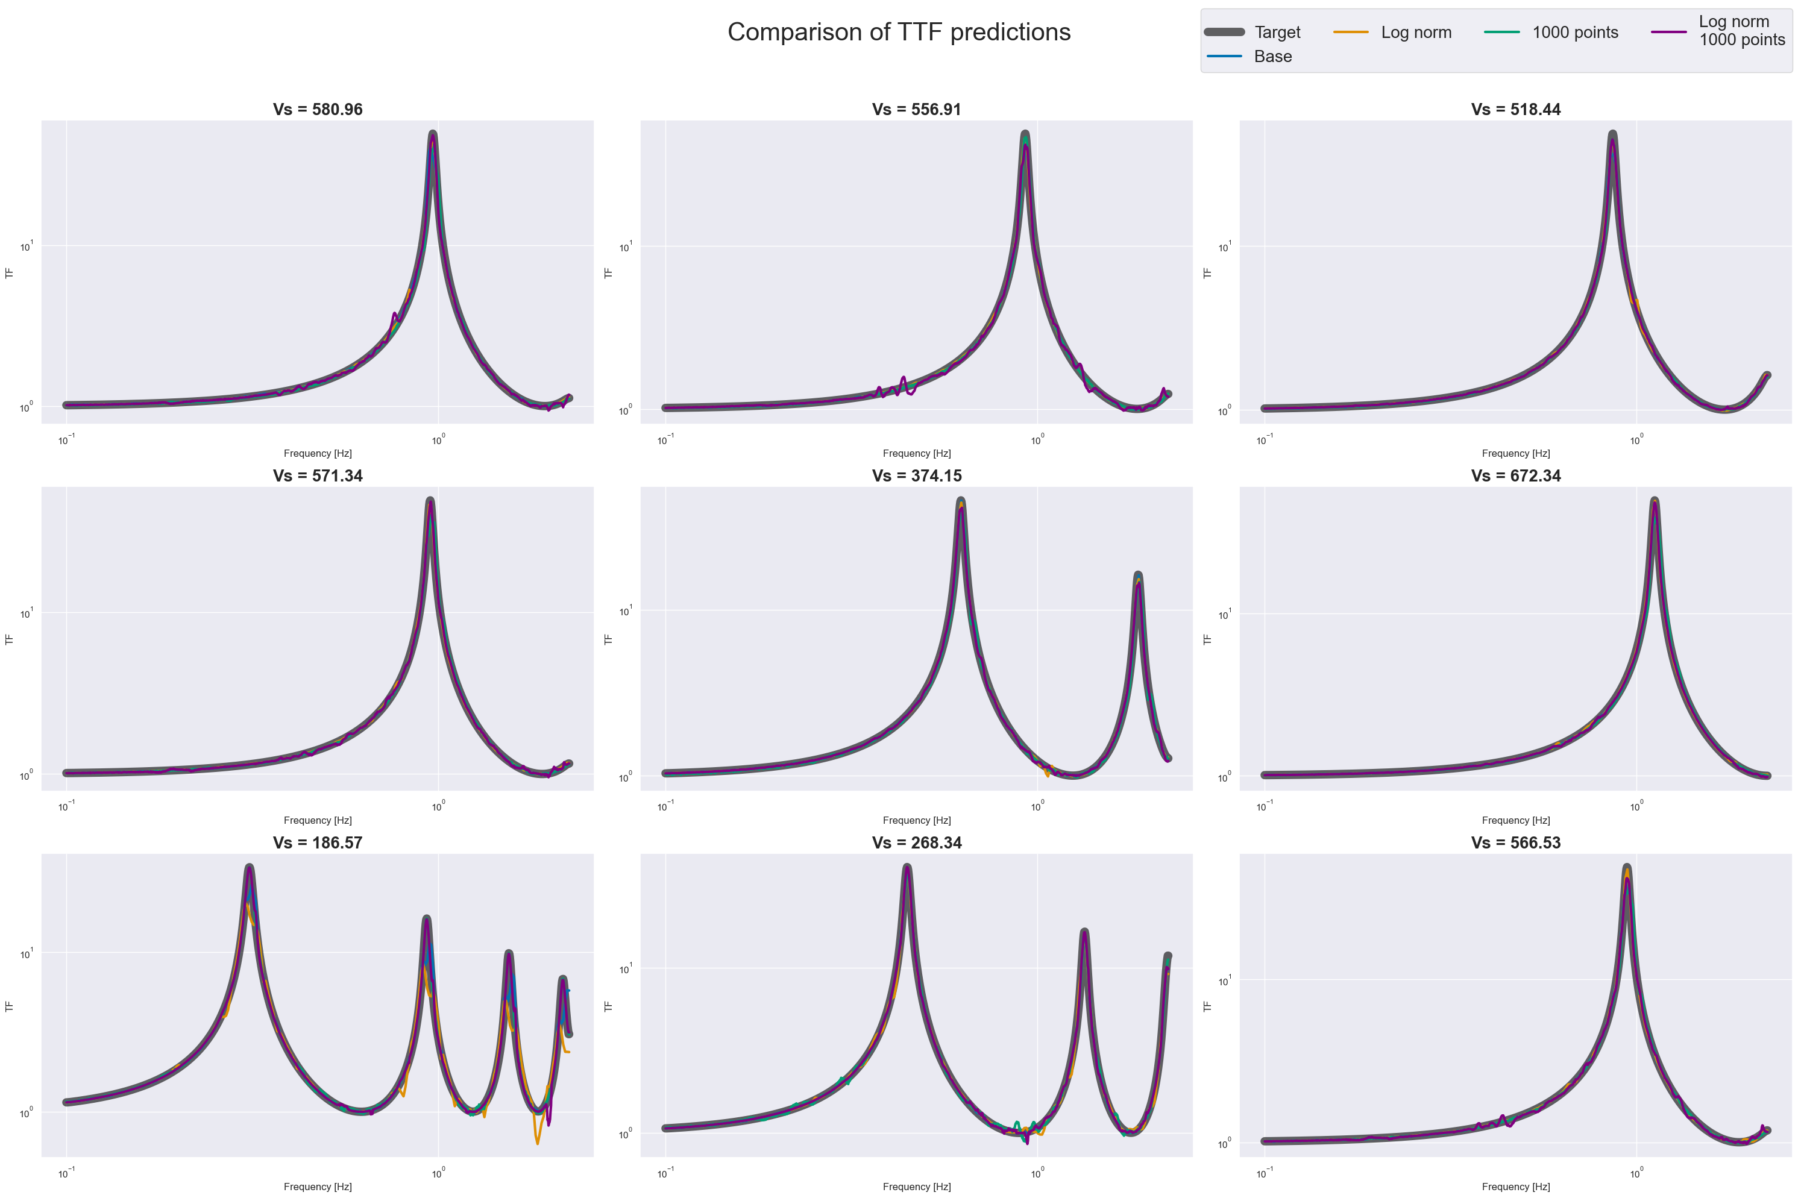

Slide 32
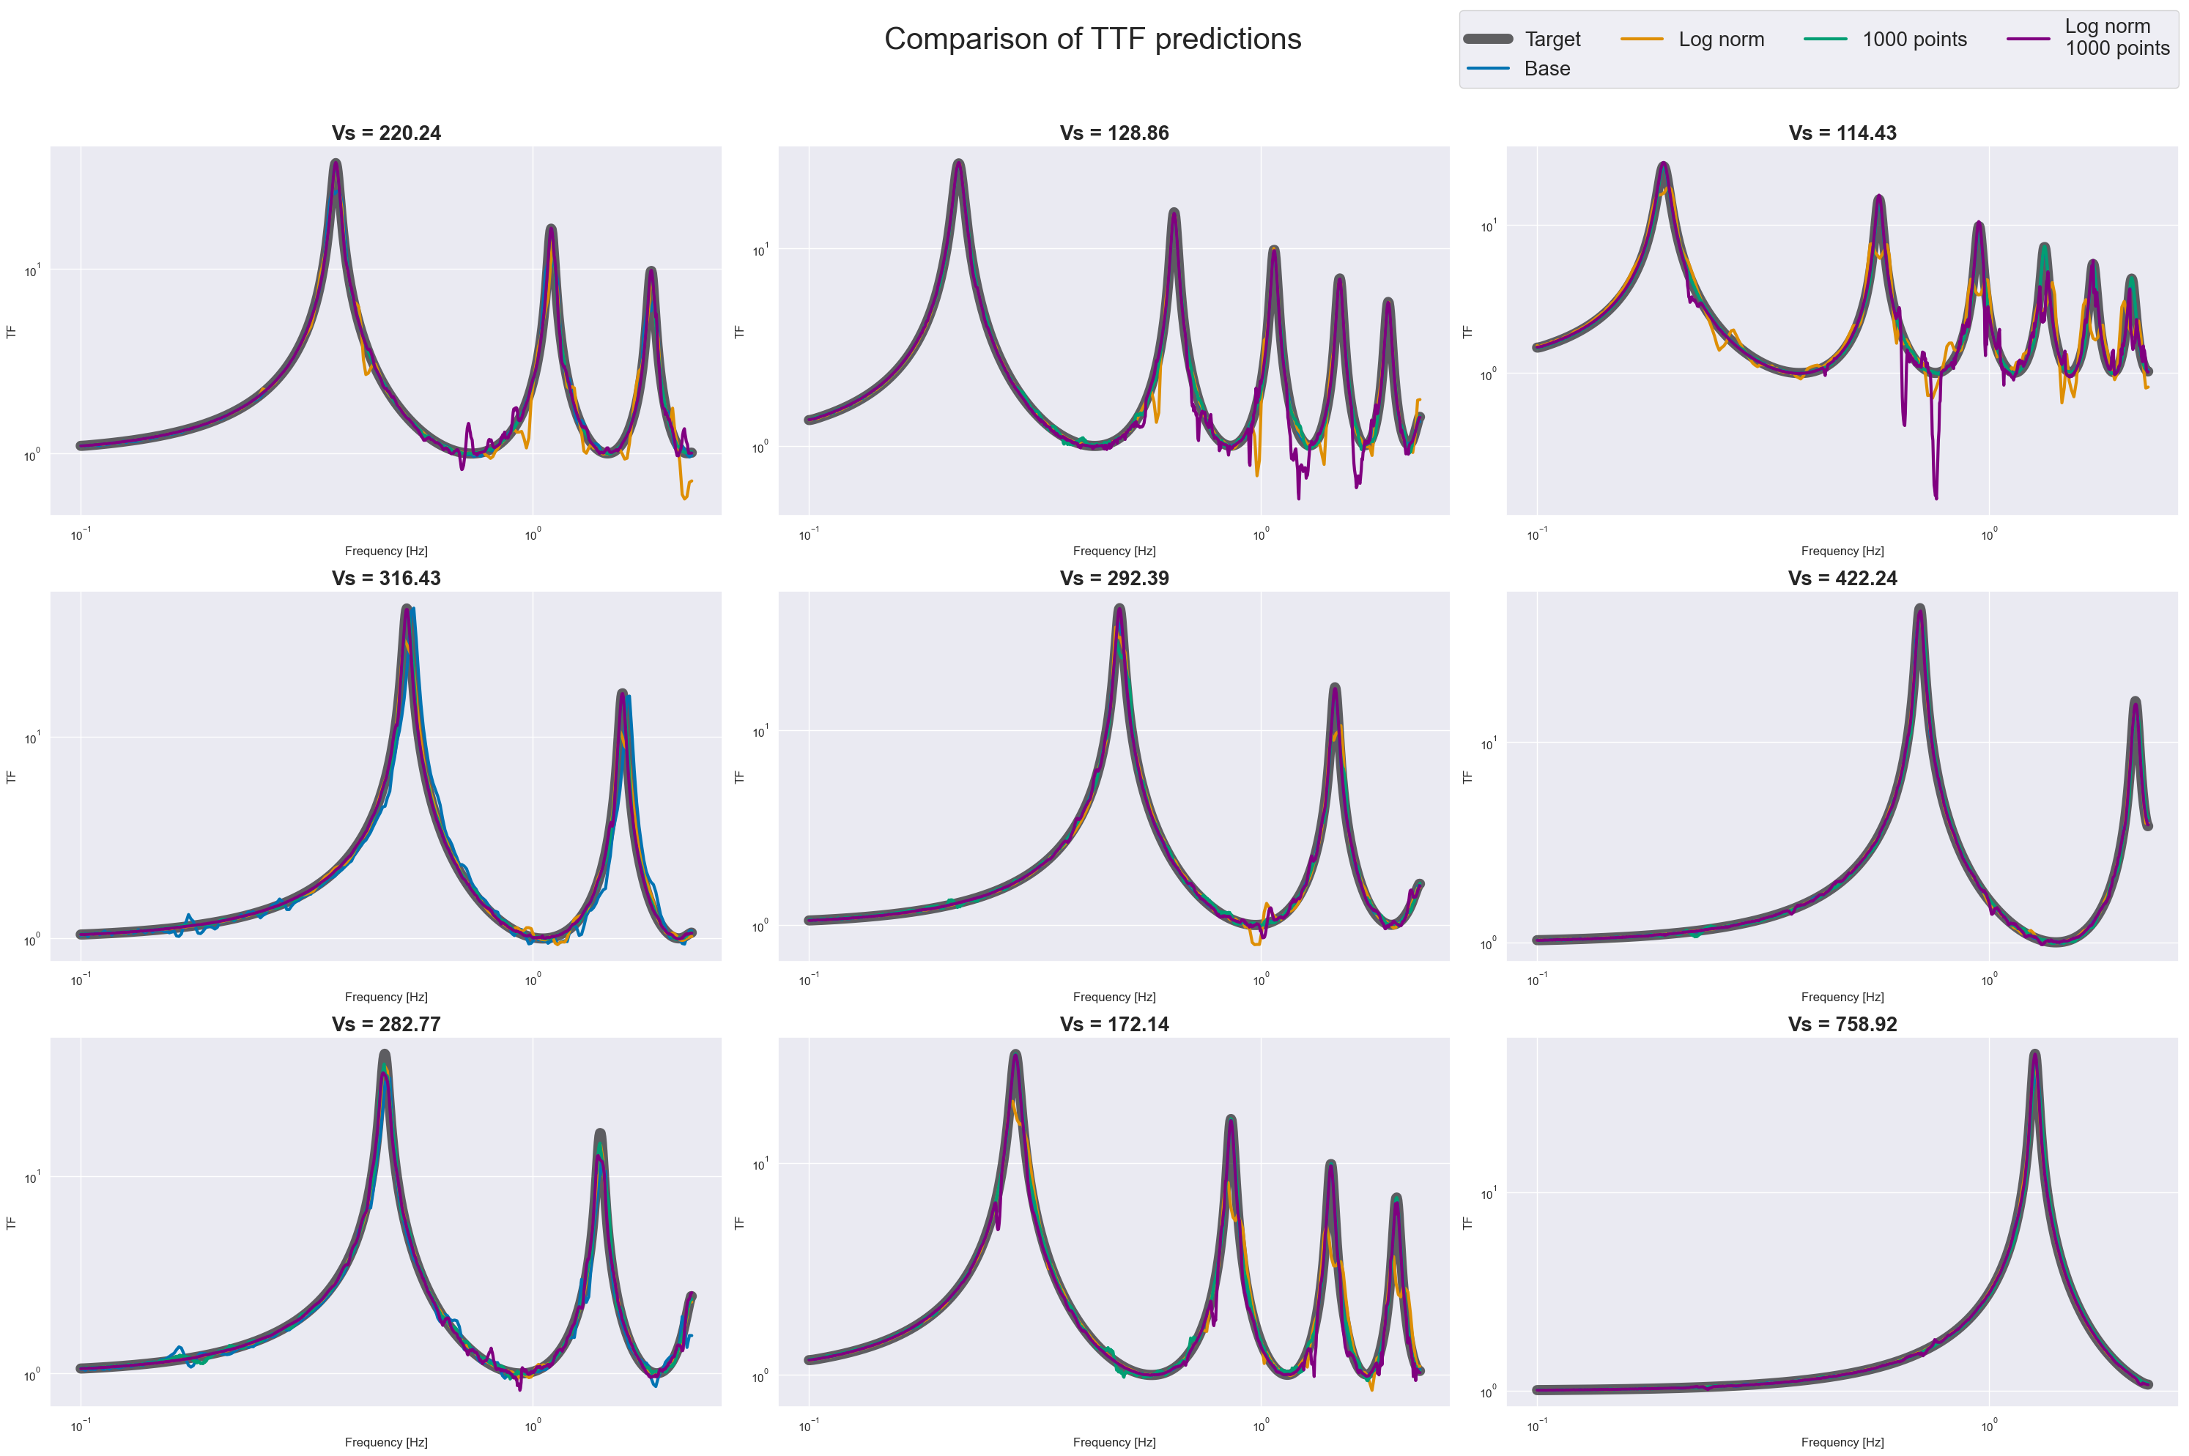

Slide 33
So, which method is the best?
Log norm presents the most correlation factor.
Increasing the number of points to 1000 does not improve the performance.

Slide 34
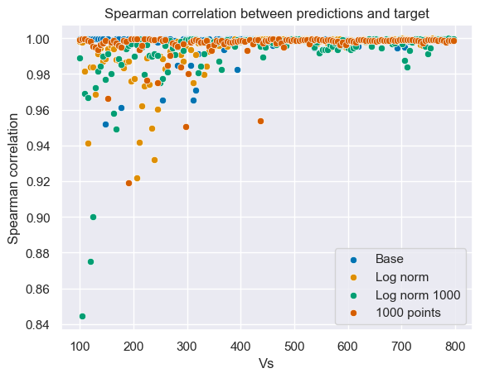
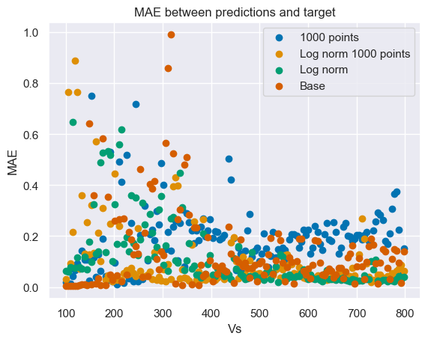
Other metrics

Slide 35
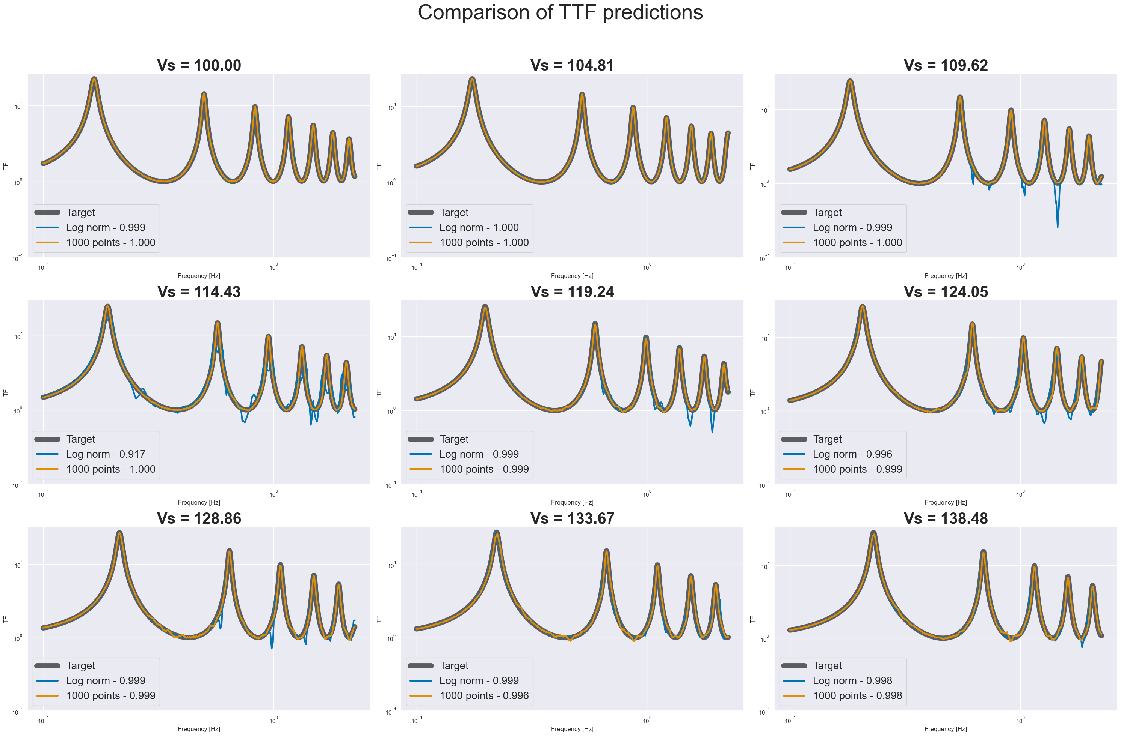

Slide 36
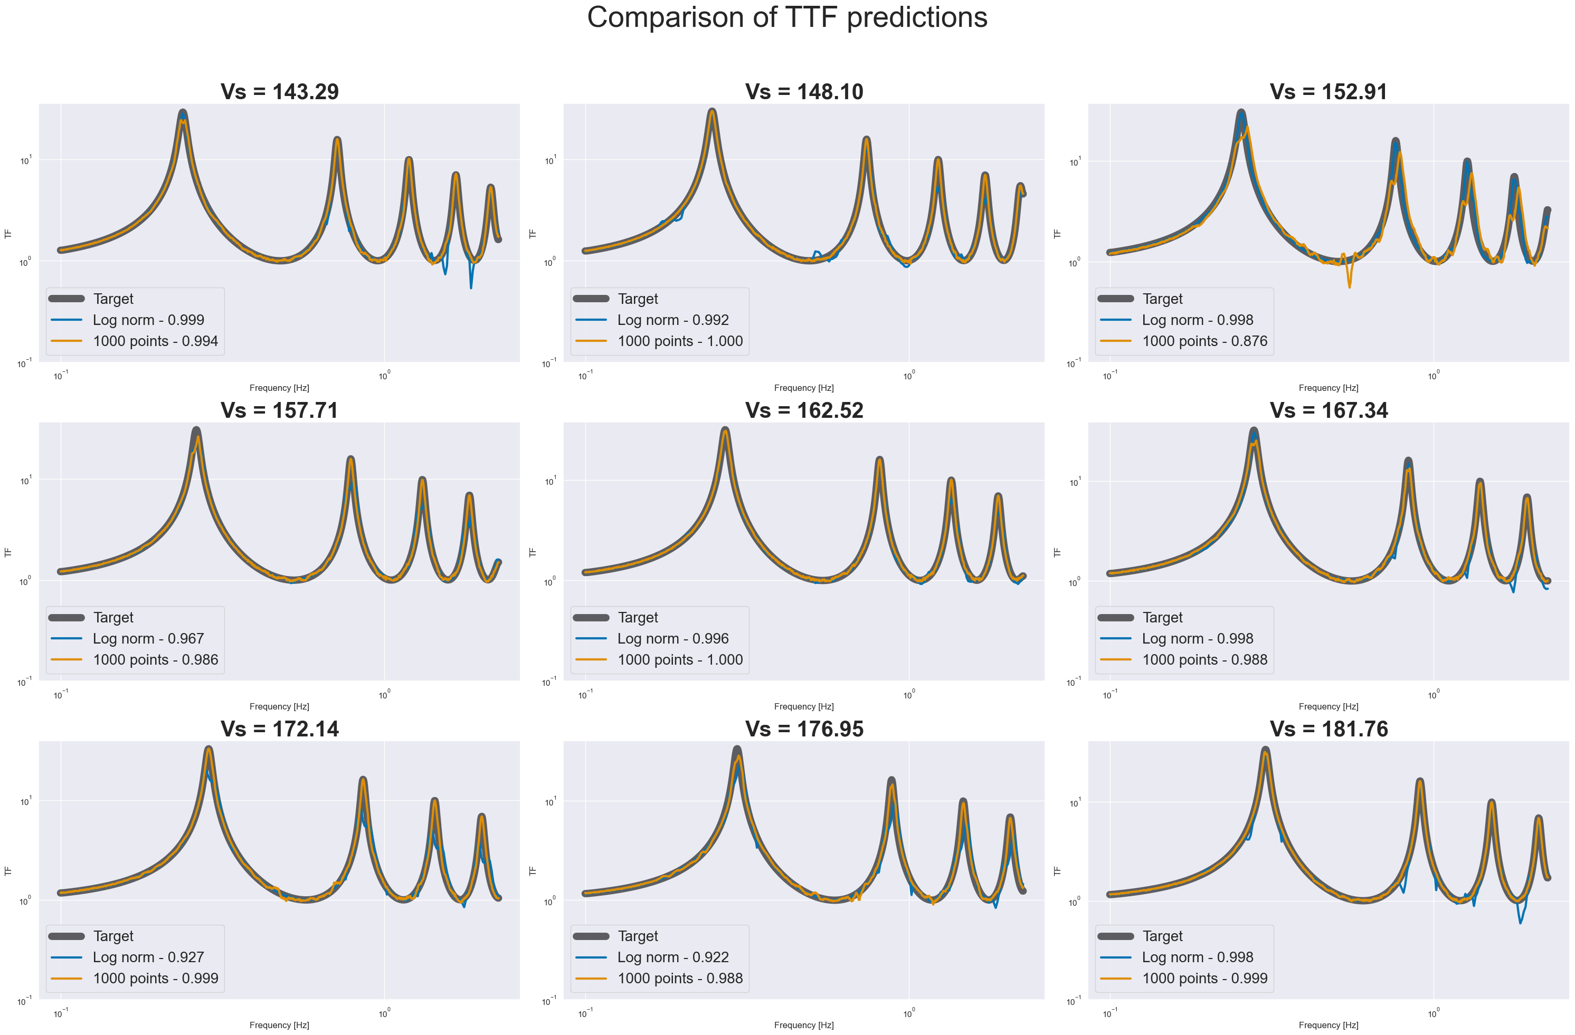

Slide 37
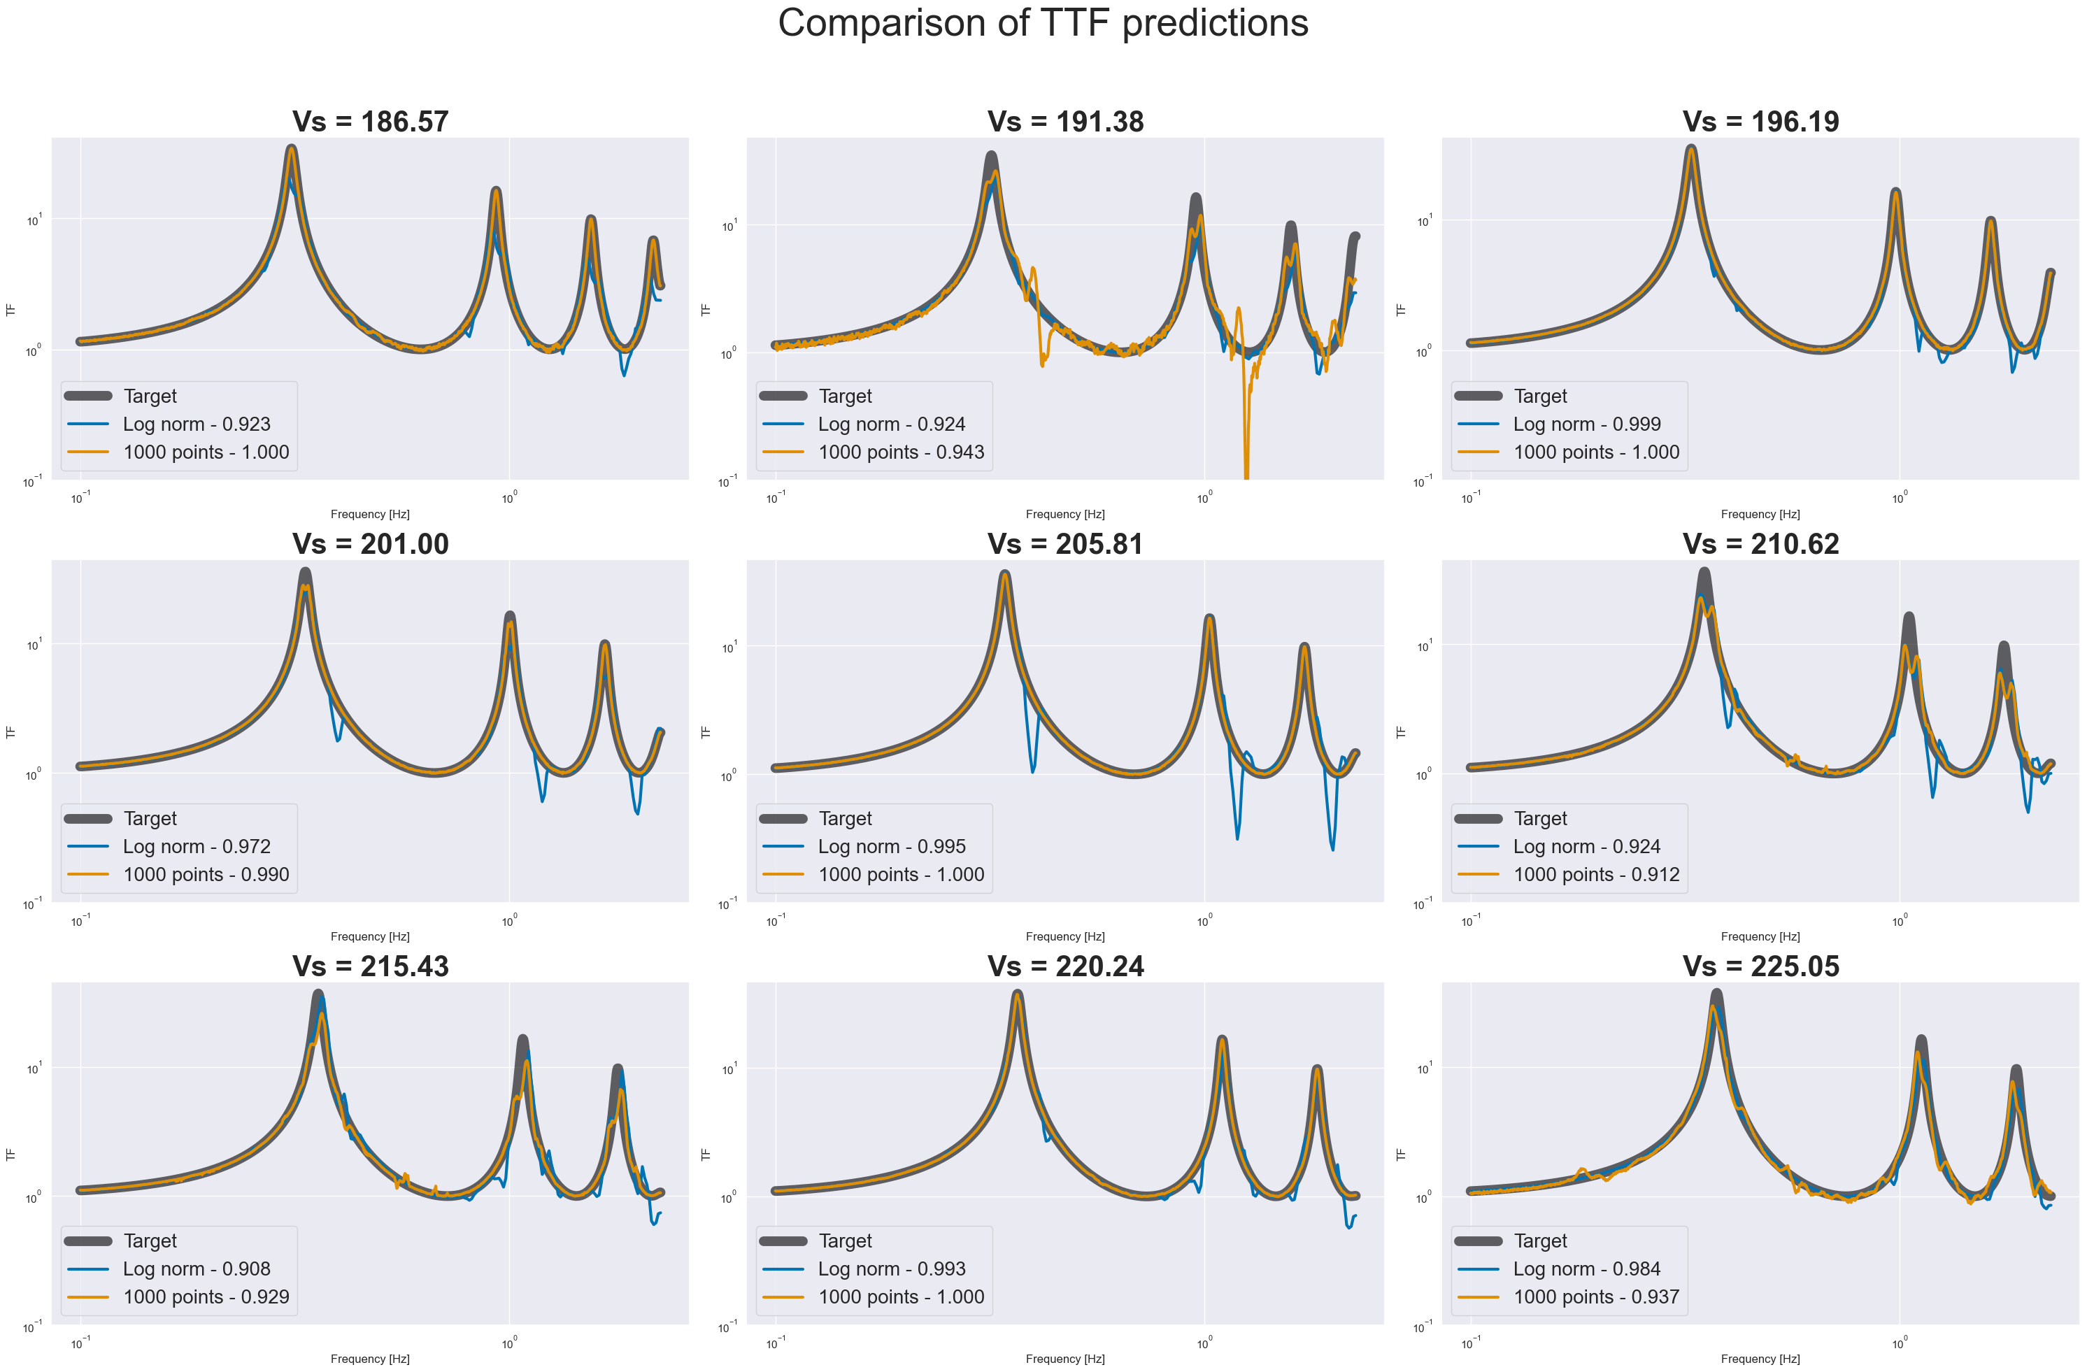

Slide 38
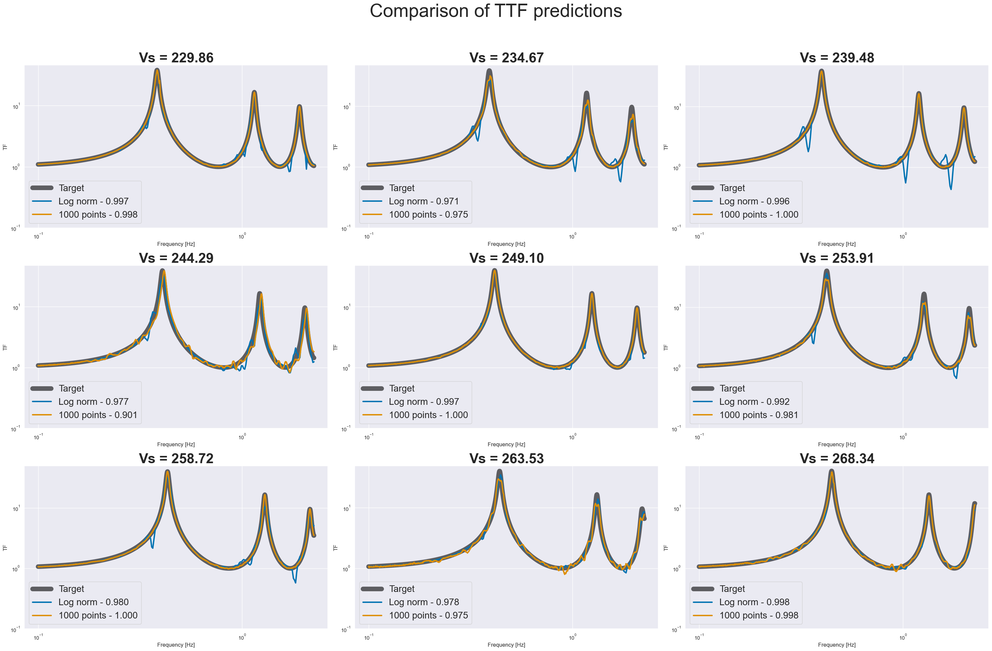

Slide 39
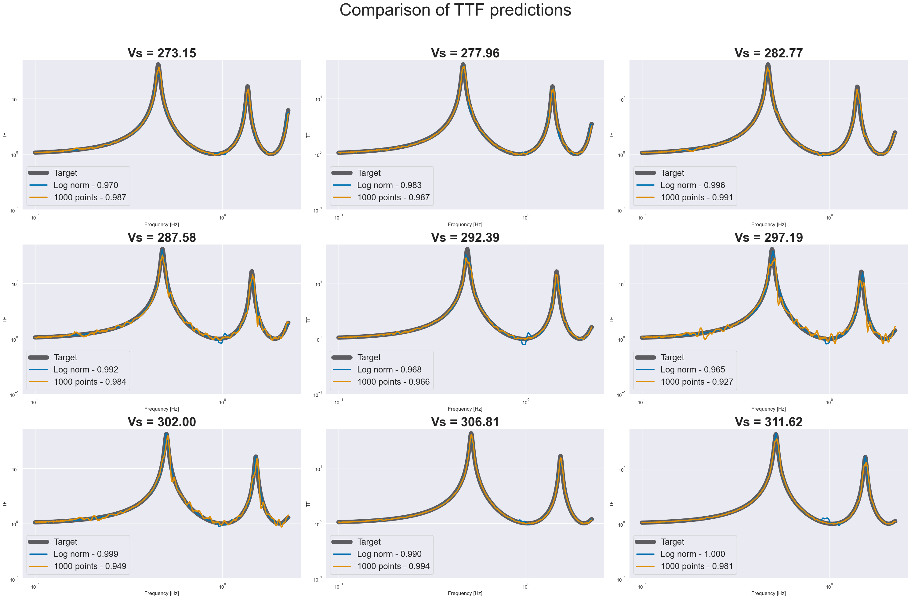

Slide 40
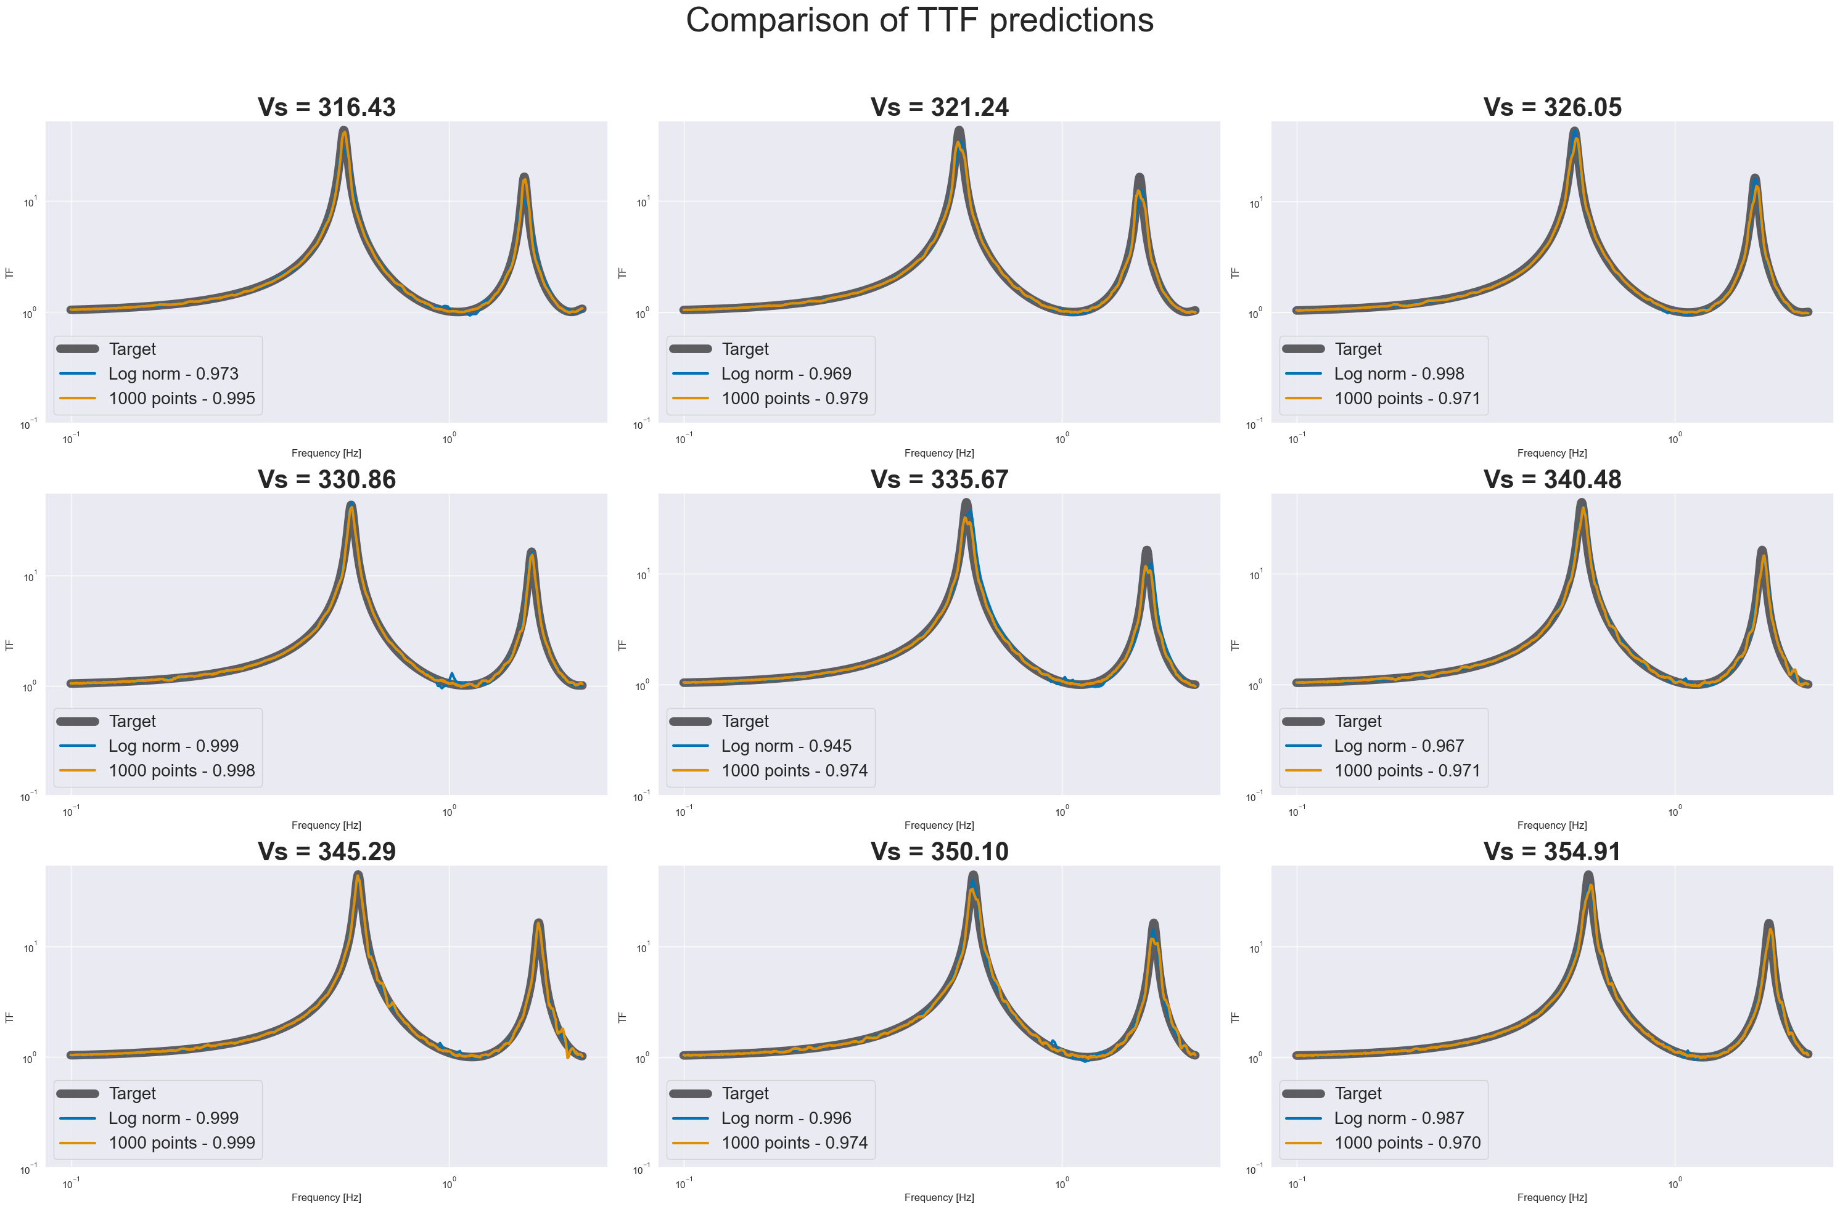

Slide 41
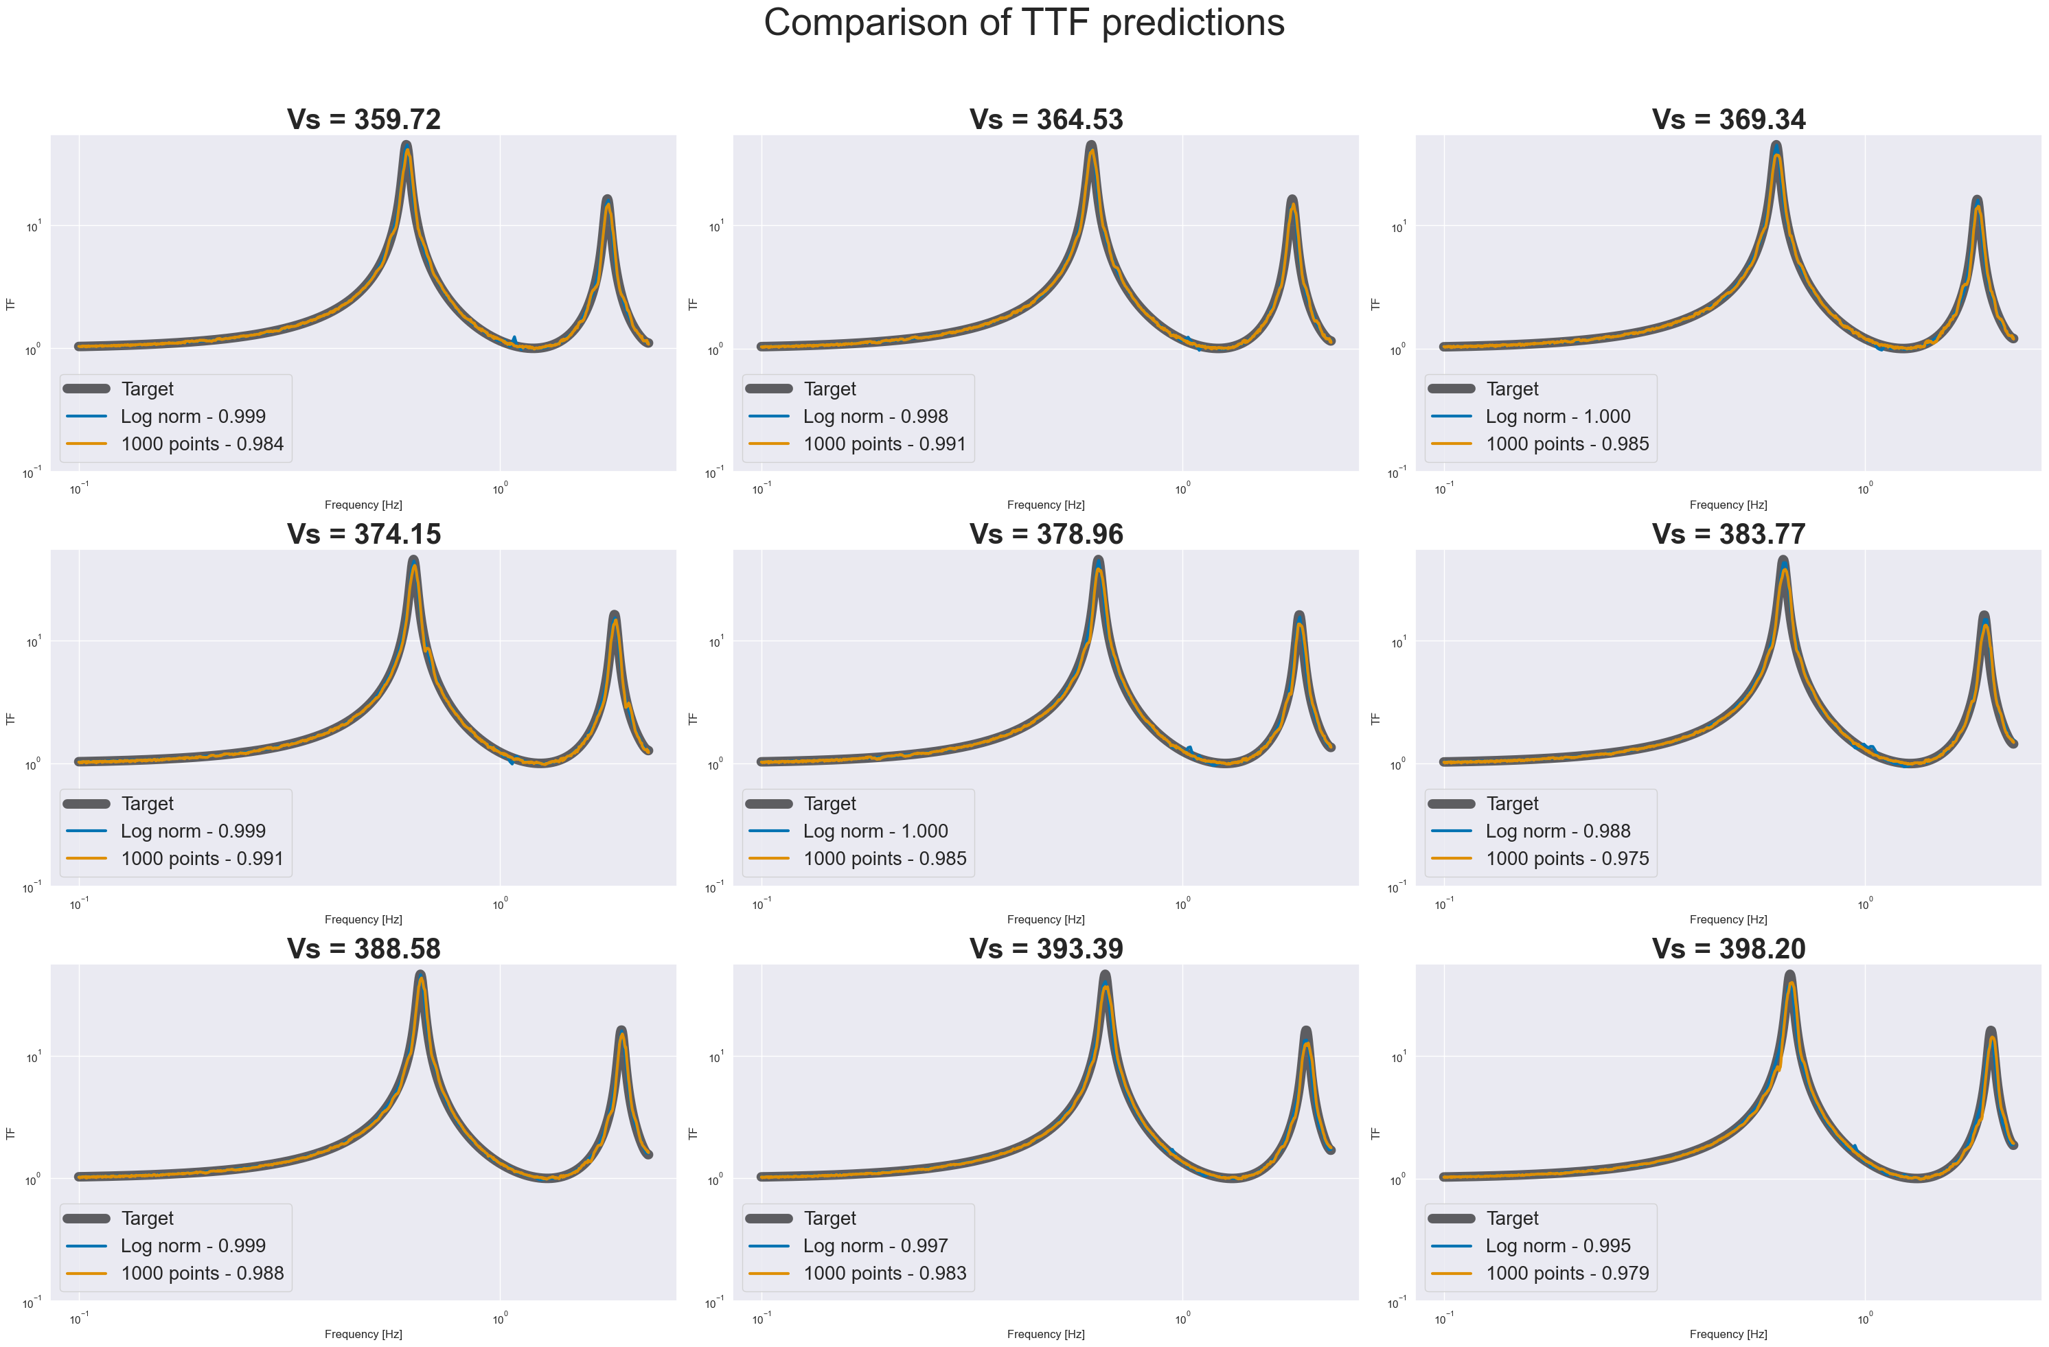

Slide 42
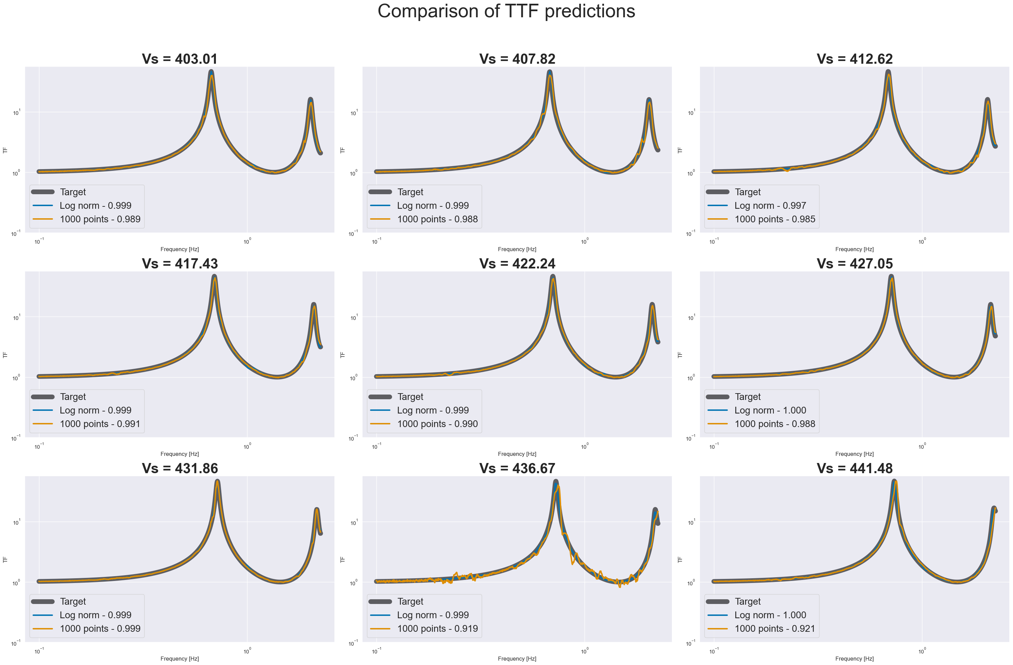

Slide 43
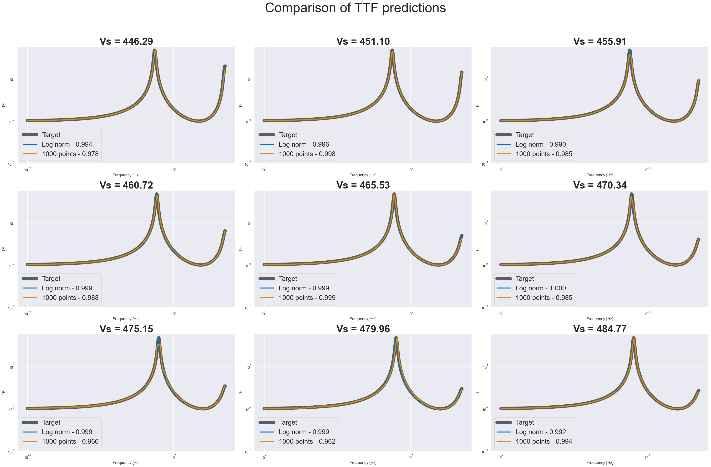

Slide 44
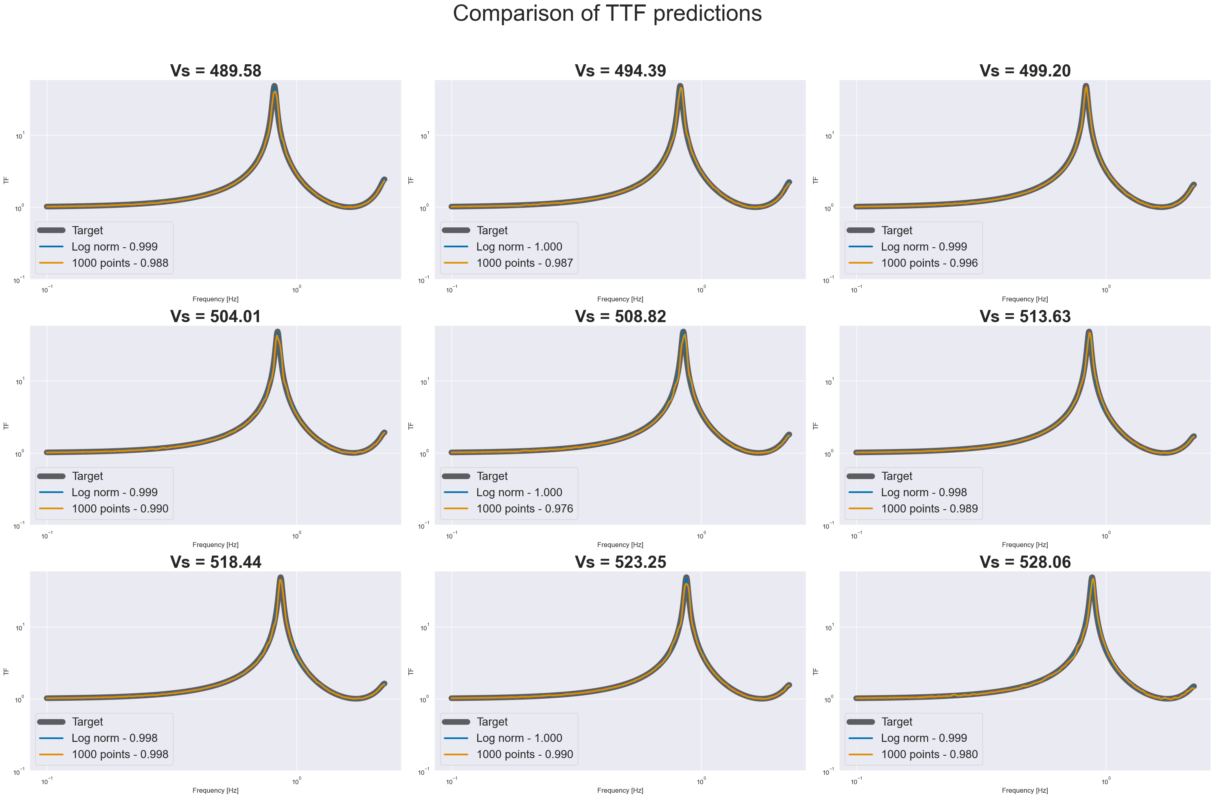

Slide 45
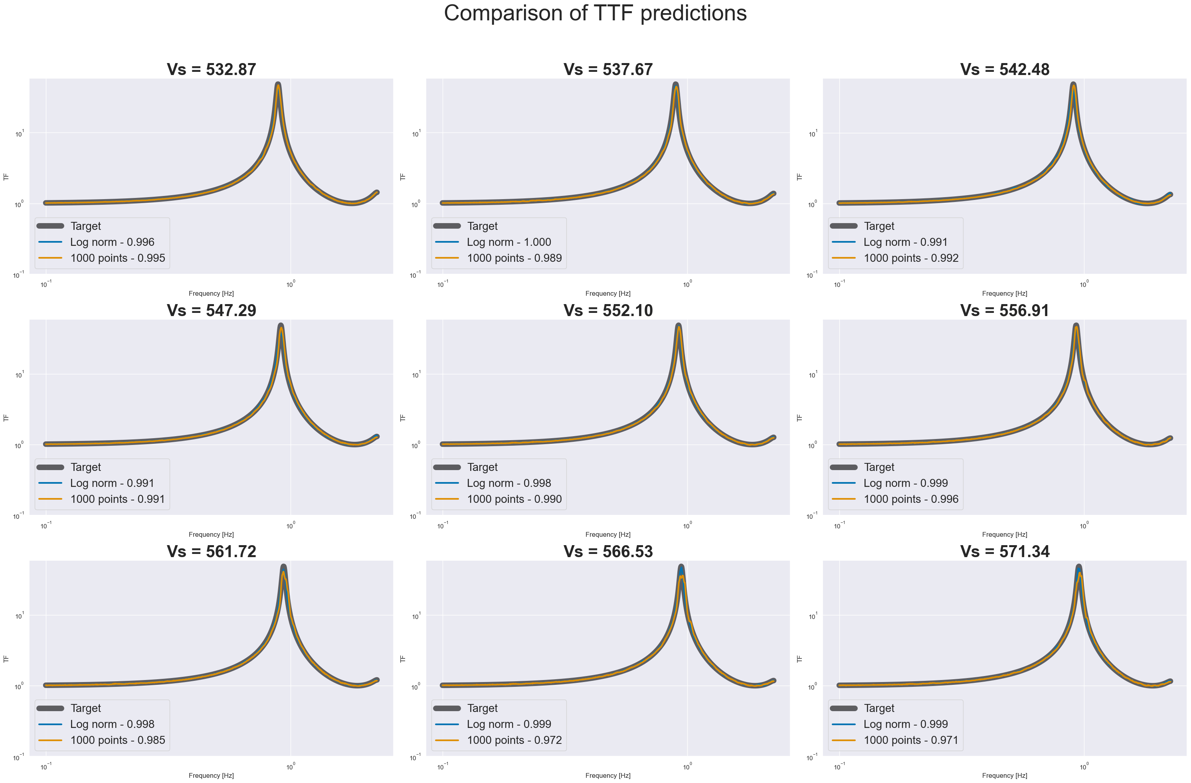

Slide 46


Slide 47


Slide 48


Slide 49


Slide 50


Slide 51


Slide 52


